Slide 1
4Links SpaceWire Codec Walkthrough

Slide 2
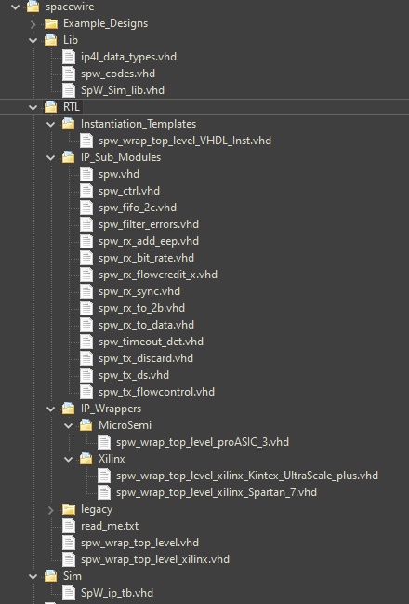
Navigating the SpaceWire Codec
IP Design Files:
~/4Links/spacewire/Lib
Library files required for IP instantiation
~/4Links/spacewire/RTL/IP_Sub_Modules
Sub-entities required for IP instantiation
~/4Links/spacewire/RTL/IP_Wrappers
Device Specific IP Wrapper Files
Notes:
The IP design files are located in the following subfolder directories

Slide 3
Instantiating the IP Core
Add all files from spacewire/Lib/ to your project.
Add all files from spacewire/RTL/IP_Sub_Modules/ to your project
Add the required top-level wrapper file.
Use the Instantiation Template file(s) as required.

Slide 4
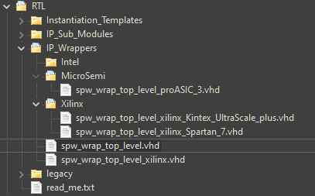
Selecting the IP Core Wrapper Version
Select a preconfigured IP wrapper for your FPGA device.
Doesn’t exist ?
Select spw_wrap_top_level.vhd and modify as required.

Slide 5

Customising the IP Core with Generics
g_clock_frequency
Sets the data-rate of the IP Core in Hz. Should be the same as the Cores’ Input Clock
Eg: 20MHz == 20Mb Tx & Rx operation.
g_tx_fifo_size
Set depth of Tx FiFo, must be greater than 8.
g_rx_fifo_size
Set depth of Rx FiFo, must be greater than 8.
g_mode
Set IO mode of the IP, “diff”, “single” and “custom”.

Slide 6
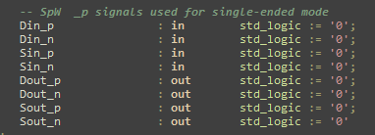
Differential & Single-Ended Modes
Differential mode (g_mode = “diff”).
In this mode, both _p & _n IO signals are used for full differential signalling.
Only available when the FPGA device supports LVDS IO Buffers.
Single-ended Mode (g_mode = “single”).
IO signals appended with _n are not used. Only IO signals appended with _p are used.
Allows for full single-ended IO operation. You can leave _n signals unconnected in the top-level design. By default these will be initialized logic ‘0’ for simulation.
For these modes relevant IO buffers DDR registers are instantiated within the IP core architecture.

Slide 7
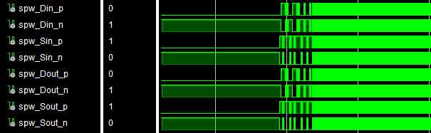
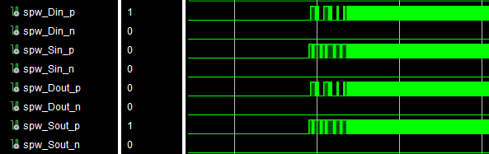
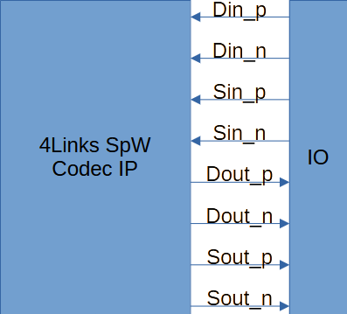
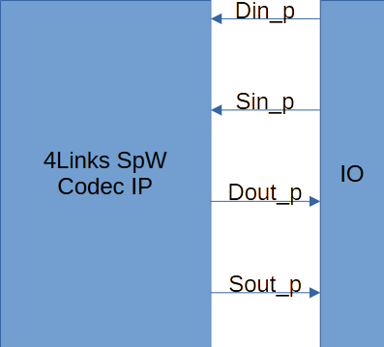
IO Simulation Waveforms
Differential IO Mode
Single-Ended IO Mode

Slide 8
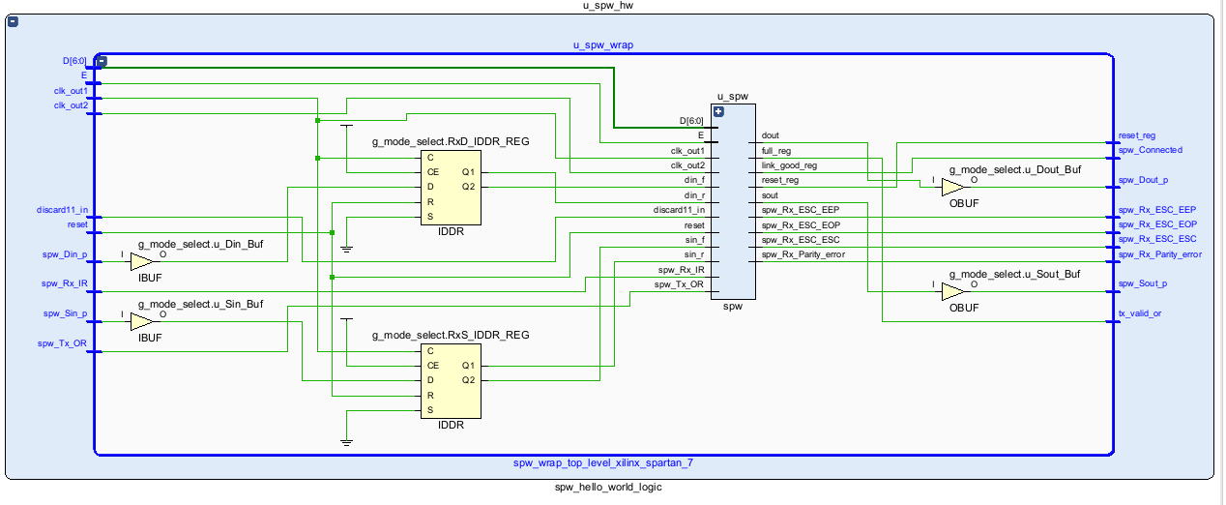

Slide 9
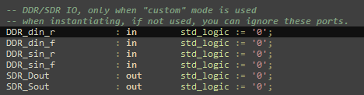
Using Custom IO Modes
Custom IO Mode (g_mode = “custom”).
When selected, the Din/Sin/Dout/Sout interface ports are disabled and set logic ‘0’.
Instead, the DDR_ & SDR_ ports are used.
DDR_d/sin_r and DDR_d/sin_f ports should be connected to the rising and falling edge outputs of a DDR input register. The input to this DDR register should be connected to an IO buffer.
The SDR_D/Sout ports should be connected directly to an IO buffer on the FPGA.
The custom mode is intended to be used with Block-Diagram projects across multiple toolchains or when you require primitives to be instantiated outside of the IP architecture.

Slide 10
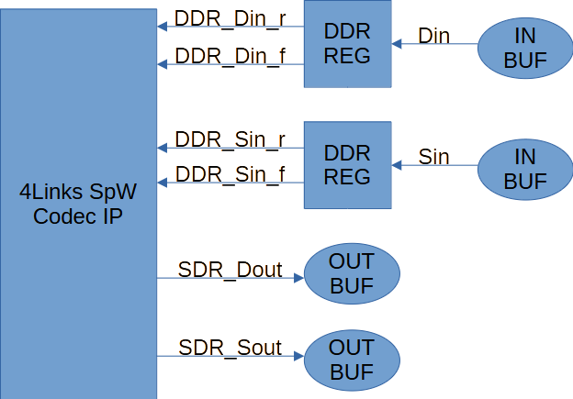
Custom IO Mode Example Diagram
Note that DDR Registers & IO Primitives are external to the SpW Codec Architecture

Slide 11
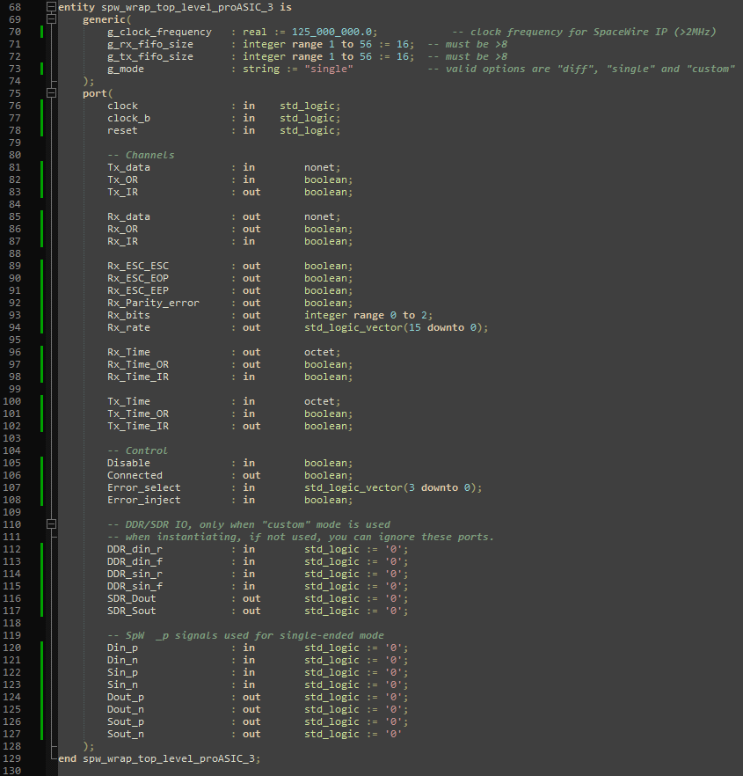
New Entity Ports for the SpW IP

